Slide 1
Better Regulation
Expenditure Forecast Assessment Guideline
Category analysis
Replacement and augmentation capex
electricity transmission
7 March 2013

Slide 2
Agenda
13:15 | Introductions
13:30 | Recap of past workshops
13:45 | Replacements Existing approach Boundary issues – replacements v other Boundary issues – replacements sub-categories Environmental factors
15:00 | Break

Slide 3
Agenda (cont)
15:15 | Augmentations Existing approach Boundary issues – augmentations v other Boundary issues – augmentations sub-categories Environmental factors
16:30 | Summary
16:50 | Next steps

Slide 4
Recap
Category analysis
  Focus on unit rates
    Activity units per volume unit
    Cost per activity unit
    Historical trends
    Benchmarking
  Requires expenditure & volumes data

Slide 5
Where are we today?
20 Dec 2012
Issues paper
12 Feb 2013
Initial Roundtable
28 Feb 2013
Category selection
Replacement/Demand
7/8 Mar 2013
Connection/Customer
19/20Mar 2013
Repex/Augex models
27Mar 2013
Opex
11 Apr 2013
Overheads
24 Apr 2013
Base-step-trend/Productivity
8 May 2013
Cost allocation and accounting
16 May 2013
Expenditure setting process
30 May 2013

Slide 6
Recap from last workshop
Replacements
Drivers and measures:
  Condition is the main driver (age may be used as a proxy)
  Obsolescence
  Safety?
  Third party (accidents)
  Exogenous factors (environment, etc)

Slide 7
Recap from last workshop
Replacements (cont)
Issues:
  NSPs at different stages of life cycle
  Are age profiles and condition profiles correlated?
  Hard to compare condition
    Different risk assessment approaches, standards
  Different asset management / risk profiles
    Replace v maintain
    STPIS trade-off

Slide 8
Recap from last workshop
Augmentation
  Definition:
    Shared network reinforcement
  Drivers & Measures:
    Driven by load growth impacting security, reliability, market benefits
  Challenges and issues:
    Different drivers for transmission and distribution
    Incorporating effects of solar PV (distribution)

Slide 9
Objectives for today
Run through draft AER models
Identify category and other data to support
  Models
  Other benchmarking / analysis
  Annual performance reports
Identify key categories for replacements and augmentations capex (with aim of consistency)

Slide 10
Replacements

Slide 11
Existing approach
Forensic review on project/program basis
  Limited up-front info requirements
  Further requests based on NSP documents
  Ad hoc: lack of consistency/ certainty in approach
Ongoing aim:
  Can unit rates be used more?
    Historical trends
    benchmarking
  Can Repex model be used?

Slide 12
Replacement capex regulatory tool
- AER REPEX tool
Presentation
Nuttall Consulting

Slide 13
Background - key aims of tool
Regulatory tool NOT planning/management tool
  Should account for main driver at aggregate level
    but not concerned with excessive detail
  Allow intra- and inter-company comparisons
  Targeting of matters for detailed review
  Development of benchmarks

Slide 14
Overview of tool
Similar, in principle, to tools used by other regulators and NSPs
  Ofgem in the UK, ESV, OTTER, ESCOSA, numerous NEM DNSPs
Inputs
Outputs
asset state
planning parameters
forecast replacement volumes
forecast replacement capex
asset ages and quantities
asset lives and replacement cost
forecast average ages

Slide 15
network model form
Network model - multiple asset categories
  used to improve accuracy
  allows for differences between networks
  reduce impact of aggregation
For example, for poles we may have separate categories
    softwood pole
    hardwood
    concrete
    steel pole, etc
Historically, the DNSP defined the individual asset categories
(30 – 100 separate categories)

Slide 16
Example input data

Slide 17
Example outputs

Slide 18
Questions?

Slide 19
Boundary issues - replacements
Emergency v planned
  Emergency
    Immediate rectification
    Planned, post-event replacement
  Planned, non-event-related replacement

Slide 20
Boundary issues - replacements
Age-based v non-age-based
Non-age causes of replacement needs
  Storms, bushfires & wildlife (non-recoverable)
  Vandalism & traffic accidents (recoverable)
  Augmentations
Expenditure and volume data splits

Slide 21
Boundary issues - disaggregation
Individual asset categories
  More or less detail?
    Need consistency
    Information burden v robust comparisons

Slide 22
REPEX – poles asset group – Powercor | REPEX – poles asset group – SP AusNet
Subtransmission - poles concrete | Pole class 1 (wood)
Subtransmission – poles steel | Pole class 2 (wood)
Subtransmission – poles wood | Pole class 3 (wood)
Subtransmission – poles staked | Pole concrete
HV – poles concrete | Pole steel
HV – poles steel | Pole staked
HV – poles wood
HV – poles staked
LV – poles concrete
LV – poles steel
LV – poles wood
LV – poles staked
PL & STAY – poles concrete
PL & STAY – poles steel
PL & STAY – poles wood
PL & STAY – poles staked
Aim: converge to consistent categories

Slide 23
Environmental factors
What factors influence unit rates
  Travel time / network density?
What are appropriate measures of these factors?
Consider through asset categories or normalisers?
Other relevant data?

Slide 24
Augmentations

Slide 25
Existing approach
Forensic review on project/program basis
  Limited up-front info requirements
  Further requests based on NSP documents
  Ad hoc: lack of consistency/ certainty in approach
New augex model – can it be used?

Slide 26
Augmentation capex regulatory tool
- AER augex tool
Presentation
Nuttall Consulting

Slide 27
Background - key aims
Regulatory tool NOT planning/management tool
  Should account for main driver at aggregate level
    but not concerned with excessive detail
  Allow intra- and inter-company comparisons
  Targeting of matters for detailed review
  Development of benchmarks
But not intended to determine specific network constraints and solutions

Slide 28
Overview
Outputs
forecast capacity
forecast costs
Asset state
Planning parameters
asset peak demand
utilisation thresholds
augmentation costs
asset peak demand growth forecast
asset capacity
forecast average utilisation
Similar in form to repex tool
Similar to tools used by ESV and NSPs

Slide 29
Network model form
Network model - multiple network segments
  used to improve accuracy
  allows for differences between networks
  reduce impact of aggregation
Segments represent typical planning components
  lines – load type and/or arrangements
  substations – load type and/or transformer number
  distribution feeder – load type
  distribution substations – load type
Likely that the DNSP defines the individual segments
(15 – 30 separate segments)

Slide 30
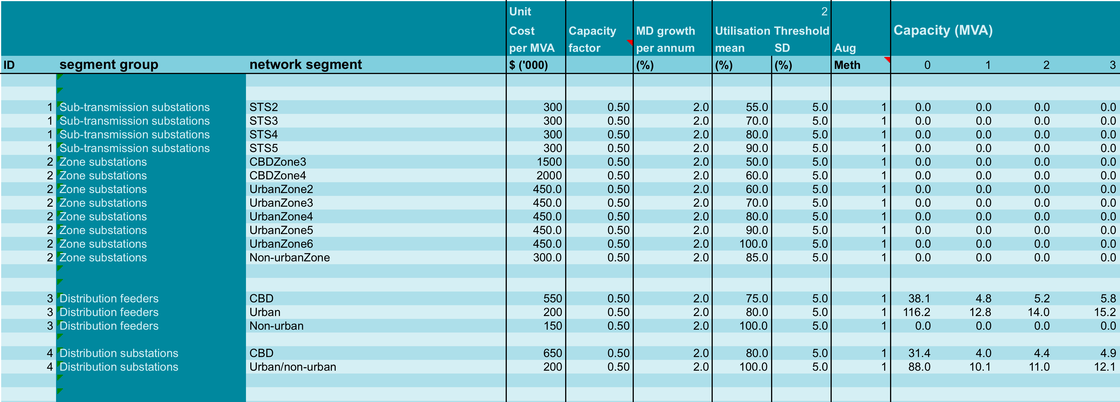
Example input data

Slide 31
Example outputs

Slide 32
Questions?

Slide 33
Boundary issues
Unit rates analysis
  MVA capacity added in response to demand
  Cost per MVA capacity added
Requires distinction between:
  Capacity-related augmentations
  Other augmentations

Slide 34
Boundary issues
Greenfield v brownfield
  Contestability?
Role of contingent projects?

Slide 35
Boundary issues
Data by network segment?
  Expenditure
  Demand
  Asset rating

Slide 36
Environmental factors
What factors influence unit rates
  Travel time / network density?
What are appropriate measures of these factors?
Consider through asset categories or normalisers?
Other relevant data?

Slide 37
Summary
Replacements

Slide 38
Summary
Augmentations

Slide 39
Next steps
date | topic
7/8 Mar | Repex, augmentation
19/20 Mar | Connections and customer driven
27 Mar | Repex and augex models, demand forecasting
11 Apr | Opex
Mid April | Joint expenditure assessment and incentives workshop
24 Apr | Overheads
8 May | Use of actual data, base step trend, productivity change
16 May | Cost allocation, accounting issues
30 May | Expenditure setting process and general issues (RIN/RIOs, first pass assessment, links with other guidelines, reconciliation of assessment methods etc)

